Slide 1
Data Mining
Navid Mohseni

Slide 2
Introduction
Data mining enables the human being to process massive amounts of data and extract all the arrangements that exists in depth, such as gold, as a valuable knowledge. This is the reason for the translation as data mining.
Accurate Prediction and Forecasting
Cost Reduction
Automated Decision-Making

Slide 3
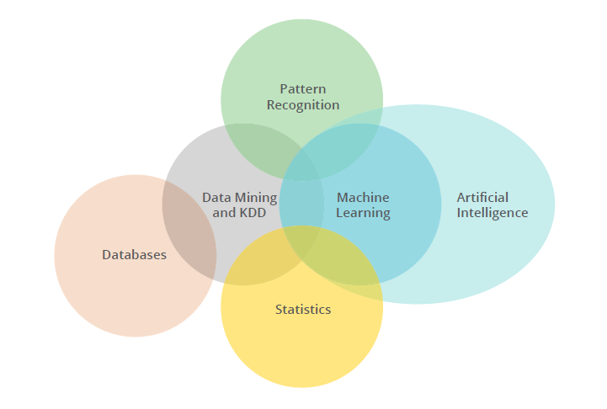
Introduction
Data mining is about solving problems by analyzing data already present in databases.
Data mining is defined as the process of discovering patterns in data.
Involving methods at the intersection of machine learning, statistics, and database systems.

Slide 4
Important Steps in Data Mining
Pre Processing
Data Modeling
Conclusions

Slide 5
Pre-Processing
Loading and integrating data from various data sources.
Cleansing data, dealing with missing values.
Scaling and normalizing data.
Transforming and reducing variables.
Partitioning the data into training, validation and test data sets.
Carrying out exploratory data analysis using graphical and statistical techniques.
Notes:
Data cleaning removes the observations containing noise and those with missing data.
In a real business application, it will be necessary to bring data together from different departments. For example, in a marketing study data will be needed from the sales department, the customer billing department, and the customer service department.
a process that has become known as data cleaning—pays off many times over. Gathering the Data Together.
When beginning work on a data mining problem, it is first necessary to bring all the data together into a set of instances.

Slide 6
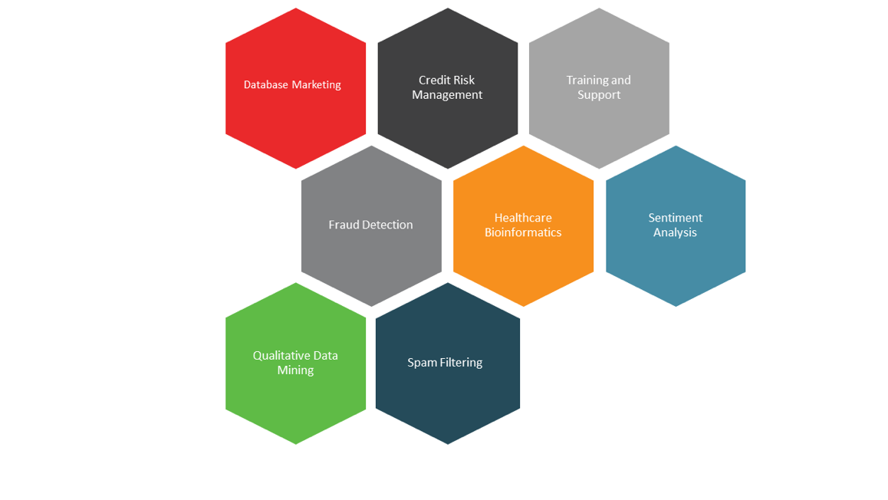
Data Modeling
Regression
Decision-trees
Association rules
K-nearest neighbors clustering methods
Neural networks
Genetic and evolution algorithms
…

Slide 7
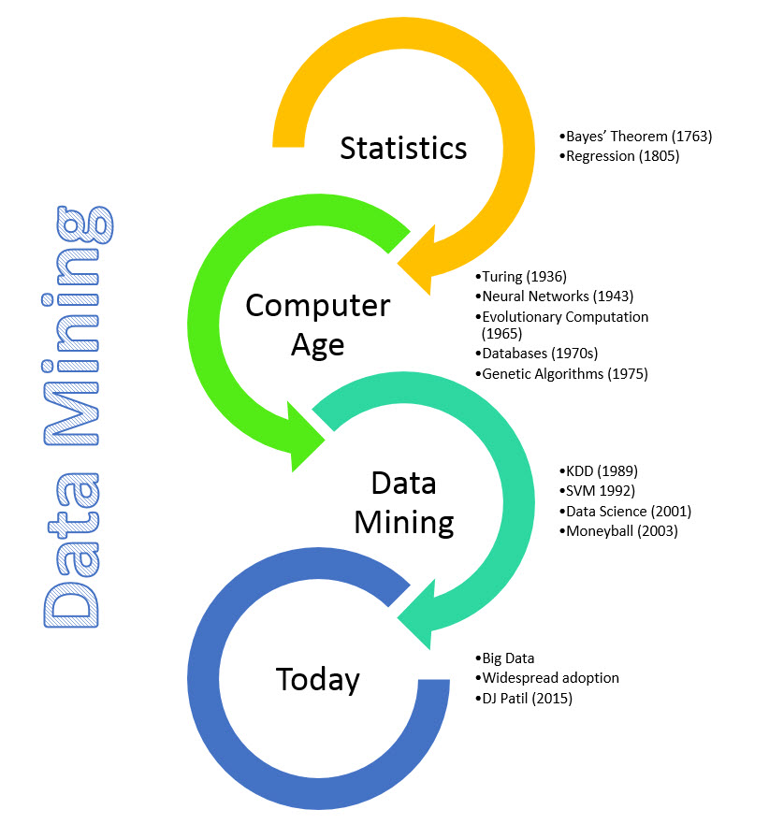
History of data Mining

Slide 8
Examples of Data Mining
Fraud Detection
Business problem: Fraud increases costs or reduces revenue.
Clicks to Customers
Business problem: 50% of Dells clients order their computer through the web. However, the retention rate is 0.5%, i.e. of visitors of Dells web page become customers.
Solution Approach: Through the sequence of their clicks, cluster customers and design website, interventions to maximize the number of customers who eventually buy.
Solution: Use logistic regression, neural nets to identify characteristics of fraudulent cases to prevent in future or prosecute more vigorously.
Benefit: Increased profits by reducing undesirable customers.
Benefit: Increase revenues.

Slide 9
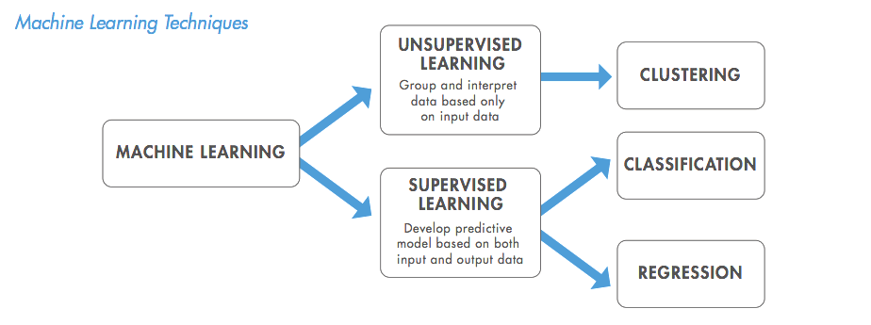
Supervised vs. Unsupervised Machine Learning
Notes:
different algorithms can be classified into two groups based on the way they “learn” about data to make predictions: supervised and unsupervised learning.

Slide 10
Supervised vs. Unsupervised Machine Learning
Supervised Learning
Basically supervised learning is a learning in which we teach or train the machine using data which is well labeled that means some data is already tagged with the correct answer.
After that, the machine is provided with a new set of examples(data) so that supervised learning algorithm analyses the data and produces a correct outcome from labeled data.
Notes:
Choosing to use either a supervised or unsupervised machine learning algorithm typically depends on factors related to the structure and volume of your data and the use case of the issue at hand

Slide 11
Supervised vs. Unsupervised Machine Learning
Unsupervised
Unsupervised learning is the training of machine using information that is neither classified nor labeled and allowing the algorithm to act on that information without guidance. Here the task of machine is to group unsorted information according to similarities, patterns and differences without any prior training of data.
Unlike supervised learning, no training will be given to the machine. Therefore machine is restricted to find the hidden structure in unlabeled data by our-self.
Notes:
Thus, the “learning algorithm” iteratively makes predictions on the training data and is corrected by the “teacher”, and the learning stops when the algorithm achieves an acceptable level of performance(or the desired accuracy)
Here, the previous work is called as training data in Data Mining terminology

Slide 12
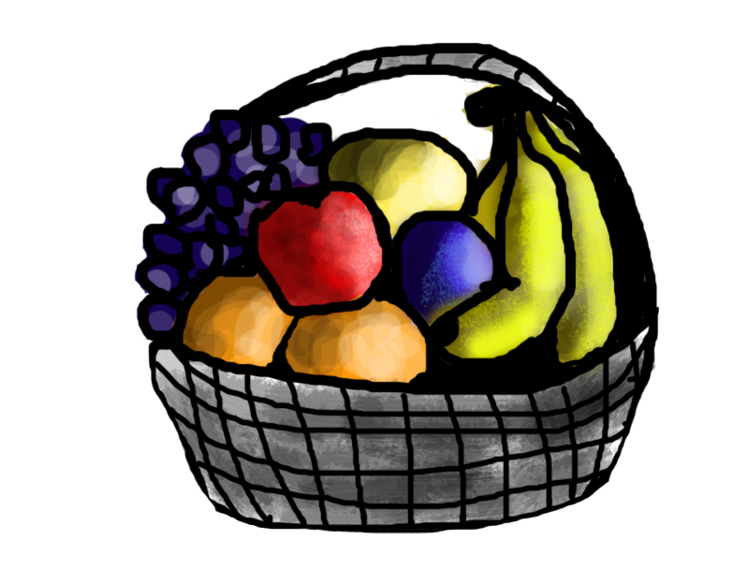

Instances
If shape of object is rounded and depression at top having color Red then it will be labelled as –Apple.
If shape of object is long curving cylinder having color Green-Yellow then it will be labelled as –Banana.
Since the machine has already learned the things from previous data and this time have to use it wisely. It will first classify the fruit with its shape and color and would confirm the fruit name as BANANA and put it in Banana category. Thus the machine learns the things from training data(basket containing fruits) and then apply the knowledge to test data(new fruit).

Slide 13
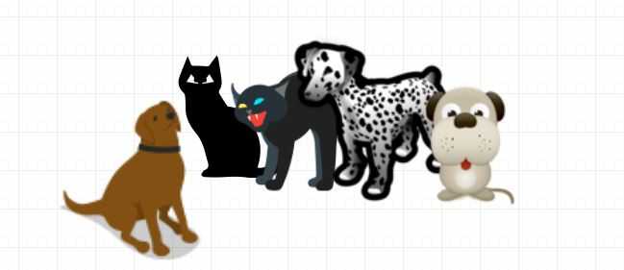
Instances
First may contain all pics having dogs in it and second part may contain all pics having cats in it. Here you didn’t learn anything before, means no training data or examples.
Suppose it is given an image having both dogs and cats which have not seen ever
Thus the machine has no idea about the features of dogs and cat so we can’t categorize it in dogs and cats. But it can categorize them according to their similarities, patterns, and differences i.e., we can easily categorize the above picture into two parts.

Slide 14
Data Mining Six Common Classes
Anomaly detection (outlier/change/deviation detection)
Classification
Regression
Association rule learning (dependency modelling)
Clustering
Summarization

Slide 15
Anomaly detection
In data mining, anomaly detection (also outlier detection) is the identification of rare items, events or observations which raise suspicions by differing significantly from the majority of the data.
Anomalies are also referred to as outliers, novelties, noise, deviations and exceptions.
Notes:
Anomaly detection is a technique used to identify unusual patterns that do not conform to expected behavior, called outliers.
Novelty Detection is concerned with identifying an unobserved pattern in new observations not included in training data — like a sudden interest in a new channel on YouTube during Christmas, for instance. Noise removal (NR) is the process of immunizing analysis from the occurrence of unwanted observations.

Slide 16
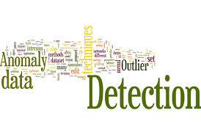
Anomaly Detection Techniques
Simple Statistical Methods
Density-Based Anomaly Detection
Clustering-Based Anomaly Detection
Support Vector Machine-Based Anomaly Detection

Slide 17
Statistical And Density-Based
Simple Statistical Methods
The simplest approach to identifying irregularities in data is to flag the data points that deviate from common statistical properties of a distribution, including mean, median, mode, and quantiles.
Density-Based Anomaly Detection
Density-based anomaly detection is based on the k-nearest neighbors algorithm. (KNN)
Assumption: Normal data points occur around a dense neighborhood and abnormalities are far away.
The nearest set of data points is evaluated using a score, which could be Euclidean distance or a similar measure dependent on the type of the data (categorical or numerical).
K-nearest neighbor: k-NN is a simple, non-parametric lazy learning technique used to classify data based on similarities in distance metrics such as Euclidean, Manhattan, Minkowski, or Hamming distance.
Relative density of data: This is better known as local outlier factor (LOF). This concept is based on a distance metric called reachability distance.

Slide 18
Clustering-Based Anomaly Detection
Clustering is one of the most popular concepts in the domain of unsupervised learning.
Assumption: Data points that are similar tend to belong to similar groups or clusters, as determined by their distance from local centroids.
K-means is a widely used clustering algorithm. It creates 'k' similar clusters of data points. Data instances that fall outside of these groups could potentially be marked as anomalies.

Slide 19
Support Vector Machine-Based Anomaly Detection
An SVM is typically associated with supervised learning.
The algorithm learns a soft boundary in order to cluster the normal data instances using the training set, and then, using the testing instance, it tunes itself to identify the abnormalities that fall outside the learned region.

Slide 20
Classification
Classification algorithms are used when the desired output is a discrete label.
Many use cases, such as determining whether an email is spam or not, have only two possible outcomes. This is called binary classification.
Multi class classification, model predicts more than one class.
Example:
Gmail classifies mails in more than one classes like social, promotions, updates, forum.
Predicting the gender of a person by his/her handwriting style

Slide 21
Classification models
Logistic regression
Decision tree
Random forest
KNN
Notes:
Gradient-boosted tree
KNN
Naive Bayes.
Neural Networks

Slide 22
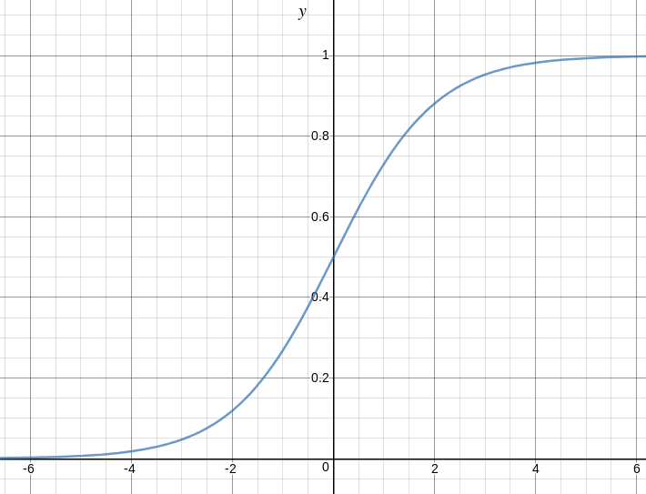
Logistic Regression
Logistic regression becomes a classification technique only when a decision threshold is brought into the picture. The setting of the threshold value is a very important aspect of Logistic regression and is dependent on the classification problem itself.
The decision for the value of the threshold value is majorly affected by the values of precision and recall:
Low Precision/High Recall
High Precision/Low Recall
Notes:
reduce the number of false negatives without necessarily reducing the number false positives
For example, in a cancer diagnosis application, we do not want any affected patient to be classified as not affected
want to reduce the number of false positives without necessarily reducing the number false negatives
For example, if we are classifying customers whether they will react positively or negatively to a personalised advertisemen

Slide 23
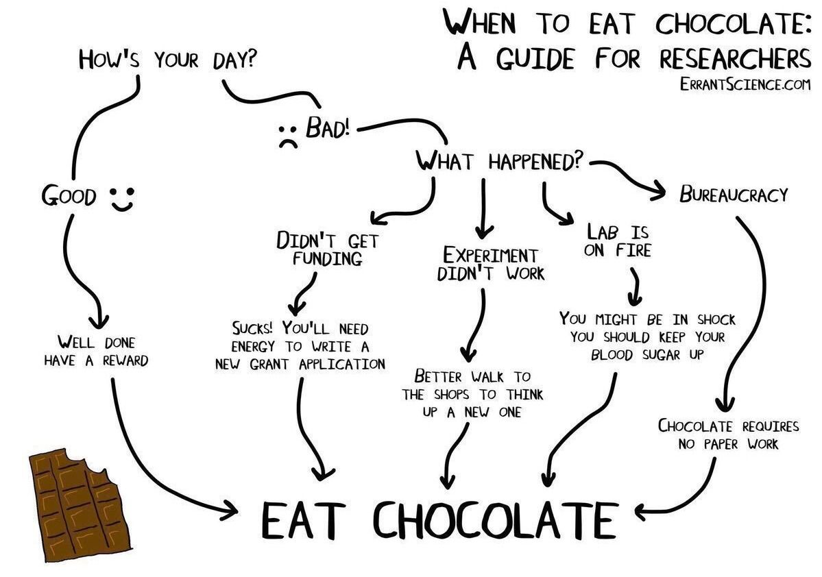
Decision Tree
Decision tree uses the tree representation to solve the problem in which each leaf node corresponds to a class label and attributes are represented on the internal node of the tree.
Assumptions of decision tree
At the beginning, we consider the whole training set as the root.
Feature values are preferred to be categorical. If the values are continuous then they are discretized prior to building the model.

Slide 24
Decision Tree
In Decision Tree the major challenge is to identification of the attribute for the root node in each level.
Information Gain
Gini Index

Slide 25
Information Gain
When we use a node in a decision tree to partition the training instances into smaller subsets the entropy changes. Information gain is a measure of this change in entropy.
Entropy Measure of uncertainty of a random variable. The higher the entropy more the information content.

Slide 26
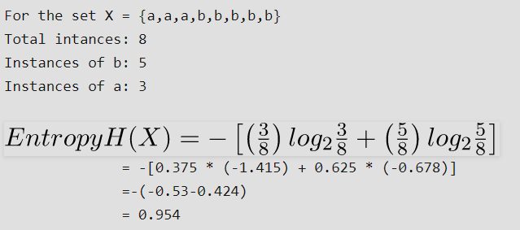
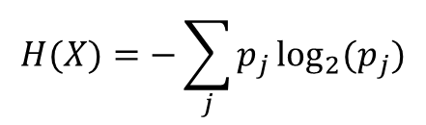
Entropy
$$H(X)=−\sum_{j}{p_{j}}\log_{2}(p_{j})$$

Slide 27
Gini Index
Gini Index is a metric to measure how often a randomly chosen element would be incorrectly identified.
It means an attribute with lower Gini index should be preferred.

Slide 28
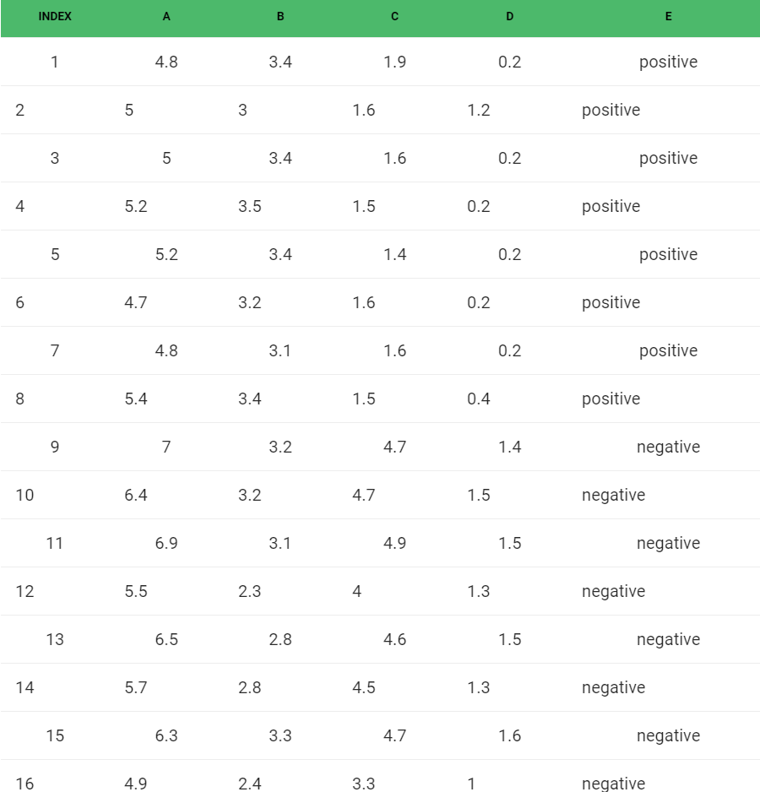
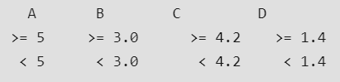
Gini Index
There are 5 attributes from which attribute E is the predicting feature which contains 2(Positive & Negative) classes.
In Gini Index, we have to choose some random values to categorize each attribute

Slide 29
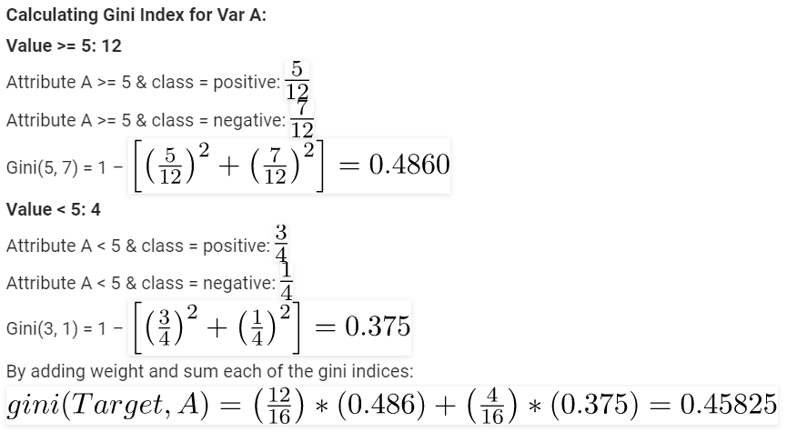
Gini Index for Variable A

Slide 30
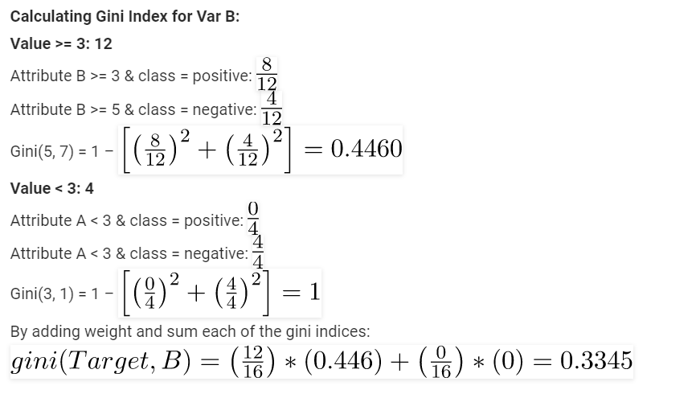
Gini Index for Variable B

Slide 31
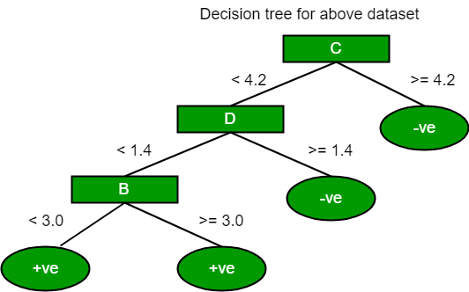
Gini Index
Gini Index of A: 0.458
Gini Index of B: 0.334
Gini Index of C: 0.2
Gini Index of D: 0.273

Slide 32
The most notable types of decision tree algorithms:
1. Iterative Dichotomiser 3 (ID3): This algorithm uses Information Gain to decide which attribute is to be used classify the current subset of the data. For each level of the tree, information gain is calculated for the remaining data recursively.
2. C4.5: This algorithm is the successor of the ID3 algorithm. This algorithm uses either Information gain or Gain ratio to decide upon the classifying attribute. It is a direct improvement from the ID3 algorithm as it can handle both continuous and missing attribute values.
3. Classification and Regression Tree(CART): It is a dynamic learning algorithm which can produce a regression tree as well as a classification tree depending upon the dependent variable.

Slide 33
Limitations of Decision Tree
Decision trees also tend to overfit on their training data—making them perform poorly if data shown to them later don’t closely match to what they were trained on.
They also can only predict within the range of labels that they’ve seen before, which means that they have explicit upper and lower bounds on the numbers they can produce.

Slide 34
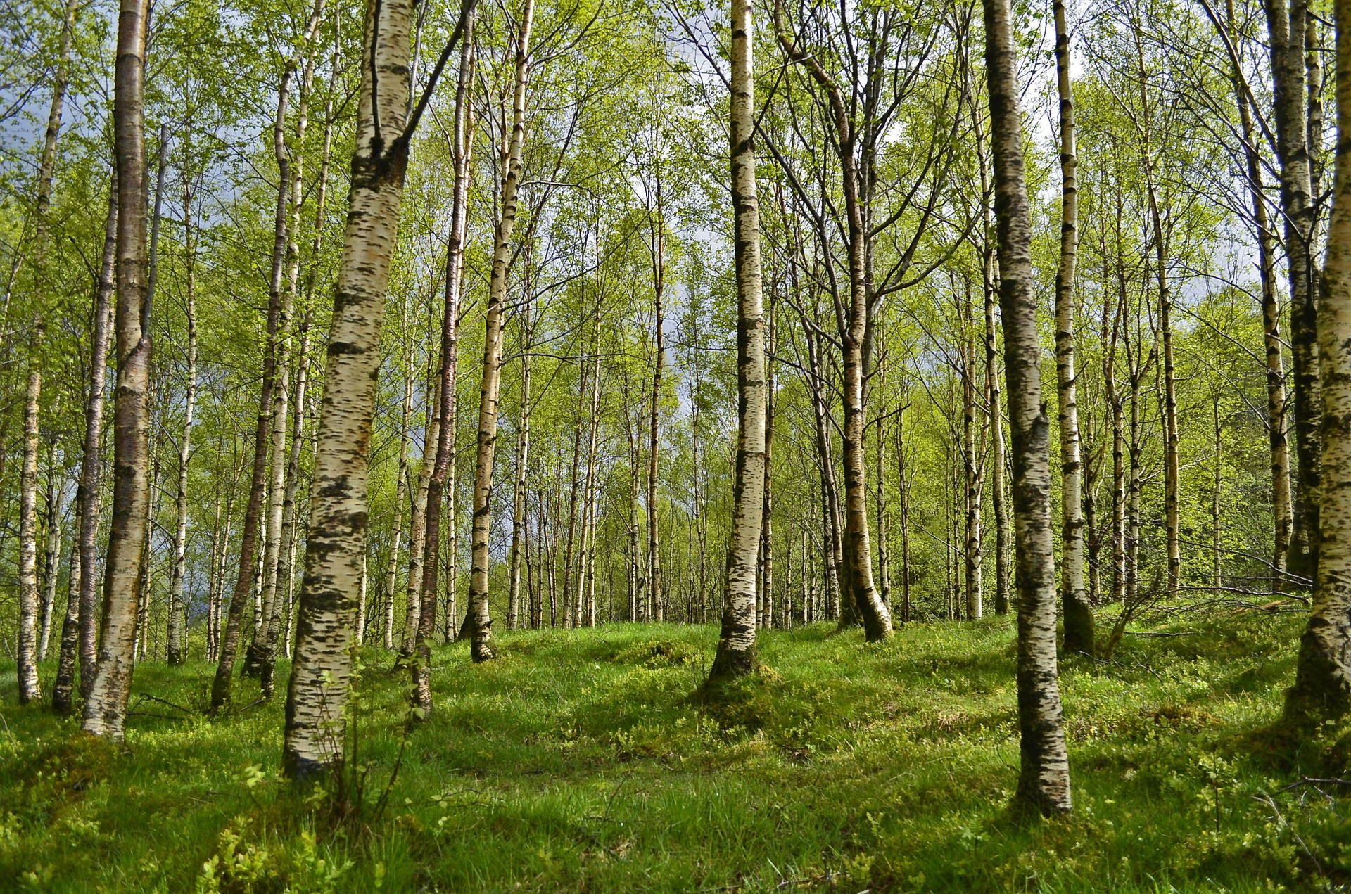

Slide 35
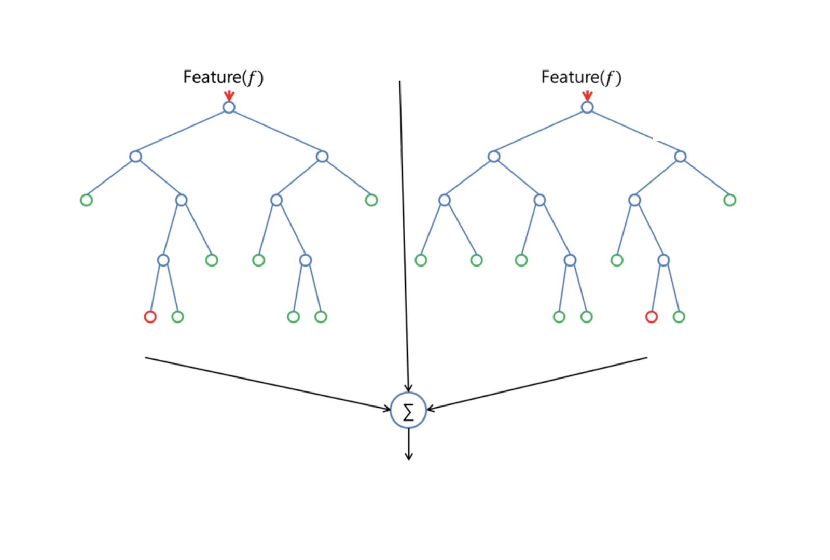
The Random Forest
Compounding hundreds or even thousands of these decision trees is an “ensemble” method called a random forest.
A random forest is comprised of a set of decision trees, each of which is trained on a random subset of the training data. These trees predictions can then be aggregated to provide a single prediction from a series of predictions.

Slide 36
Building A Random Forest
Choose the number of trees you’d like in your forest (M)
Choose the number of samples you’d like for each tree (n)
Choose the number of features you’d like in each tree (f)
For each tree in M:
Select n samples with replacement from all observations
Select f features at random
Train a decision tree using the data set of n samples with f features
Save the decision tree

Slide 37
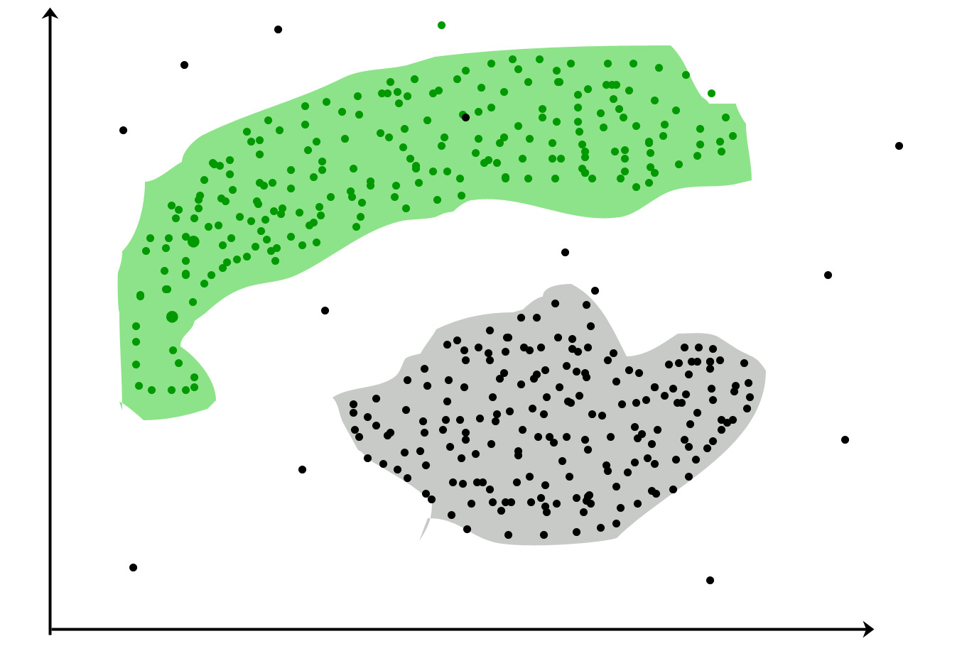
Clustering
It is basically a type of unsupervised learning method .
Clustering is the task of dividing the population or data points into a number of groups such that data points in the same groups are more similar to other data points in the same group and dissimilar to the data points in other groups. It is basically a collection of objects on the basis of similarity and dissimilarity between them

Slide 38
Clustering Examples
Libraries : It is used in clustering different books on the basis of topics and information.
Biology : It can be used for classification among different species of plants and animals.
City Planning : It is used to make groups of houses and to study their values based on their geographical locations and other factors present.
Earthquake studies : By learning the earthquake affected areas we can determine the dangerous zones.

Slide 39
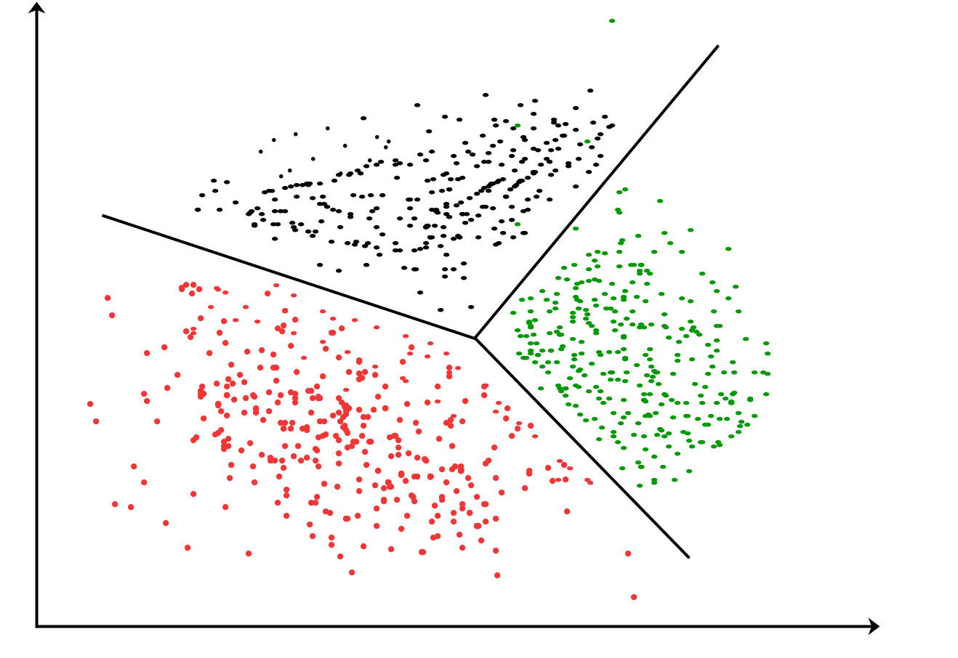
Clustering Methods :
Density-Based Methods
Hierarchical Based Methods
Partitioning Methods
Grid-based Methods

Slide 40
Density-Based Methods
These methods consider the clusters as the dense region having some similarity and different from the lower dense region of the space. These methods have good accuracy and ability to merge two clusters.
Example DBSCAN (Density-Based Spatial Clustering of Applications with Noise) , OPTICS (Ordering Points to Identify Clustering Structure) etc.

Slide 41
Hierarchical Based Methods
The clusters formed in this method forms a tree type structure based on the hierarchy.
New clusters are formed using the previously formed one. It is divided into two category: -> Agglomerative (bottom up approach) -> Divisive (top down approach) .
Examples CURE (Clustering Using Representatives), BIRCH (Balanced Iterative Reducing Clustering and using Hierarchies) etc.

Slide 42
Partitioning Methods
These methods partition the objects into k clusters and each partition forms one cluster.
Example K-means, CLARANS (Clustering Large Applications based upon randomized Search) etc.

Slide 43
Grid-based Methods
In this method the data space are formulated into a finite number of cells that form a grid-like structure. All the clustering operation done on these grids are fast and independent of the number of data objects
Example STING (Statistical Information Grid), wave cluster, CLIQUE (Clustering In Quest) etc.

Slide 44
K-means Clustering
The goal of this algorithm is to find groups in the data, with the number of groups represented by the variable K.
The algorithm works iteratively to assign each data point to one of K groups based on the features that are provided. Data points are clustered based on feature similarity.
The algorithm iterates between steps one and two until a stopping criterion is met (i.e., no data points change clusters, the sum of the distances is minimized, or some maximum number of iterations is reached).

Slide 45
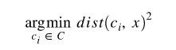
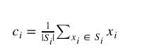
K Means Algorithm
The algorithm starts with initial estimates for the Κ centroids, which can either be randomly generated or randomly selected from the dataset. The algorithm then iterates between two steps:
1. Data assignment step:
Each centroid defines one of the clusters. In this step, each data point is assigned to its nearest centroid, based on the squared Euclidean distance. More formally, if ci is the collection of centroids in set C, then each data point x is assigned to a cluster based on
2. Centroid update step:
In this step, the centroids are recomputed. This is done by taking the mean of all data points assigned to that centroid's cluster.

Slide 46
K Means
To find the number of clusters in the data, the user needs to run the K-means clustering algorithm for a range of K values and compare the results.
In general, there is no method for determining exact value of K, but an accurate estimate can be obtained using the following techniques.

Slide 47
Techniques for validating K
Elbow Plot
Cross-validation
Information criteria
The information theoretic jump method
The silhouette method
The G-means algorithm

Slide 48
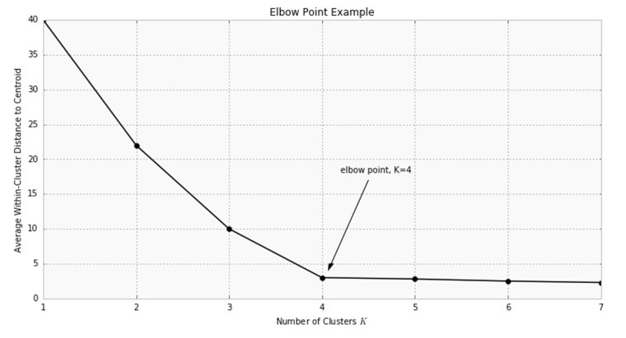
Elbow Plot
One of the metrics that is commonly used to compare results across different values of K is the mean distance between data points and their cluster centroid.
Since increasing the number of clusters will always reduce the distance to data points, increasing K will always decrease this metric, to the extreme of reaching zero when K is the same as the number of data points.
Thus, this metric cannot be used as the sole target. Instead, mean distance to the centroid as a function of K is plotted and the "elbow point," where the rate of decrease sharply shifts, can be used to roughly determine K.

Slide 49
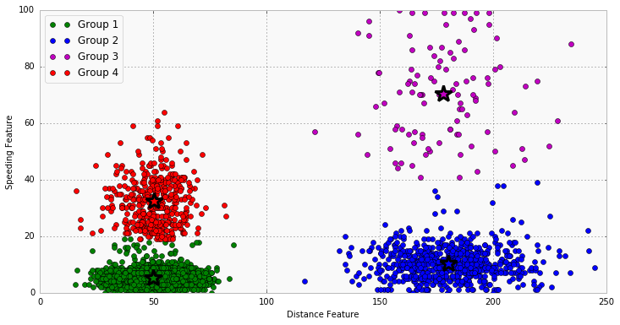
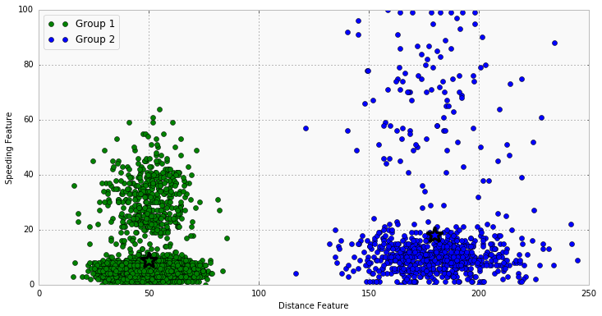
K =2 Vs K=4

Slide 50
k-Nearest Neighbors
KNN can be used for both classification and regression predictive problems. However, it is more widely used in classification problems in the industry. To evaluate any technique we generally look at 3 important aspects:
1. Ease to interpret output
2. Calculation time
3. Predictive Power

Slide 51
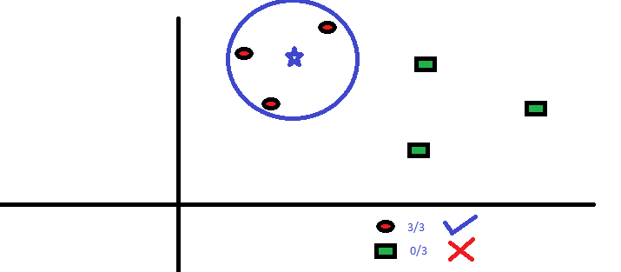
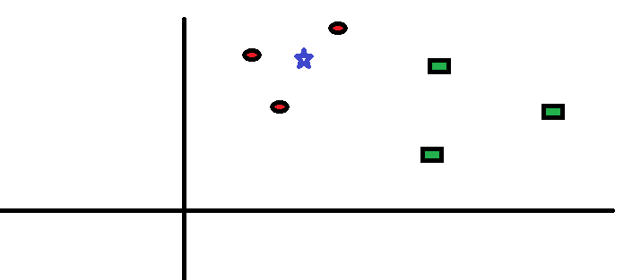
Example with K=2

Slide 52
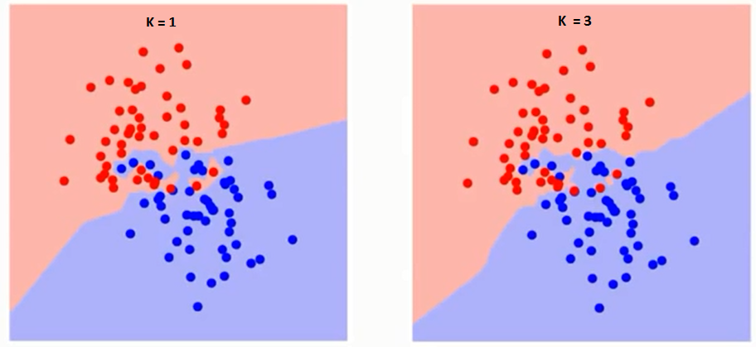
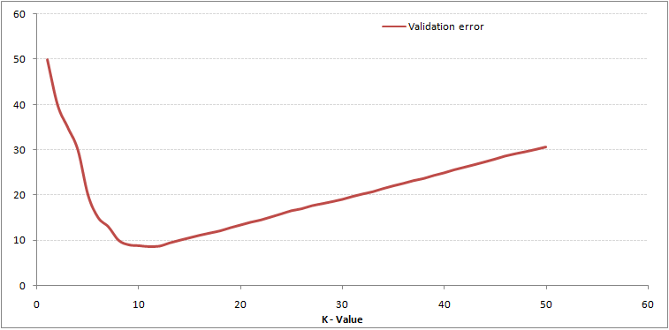
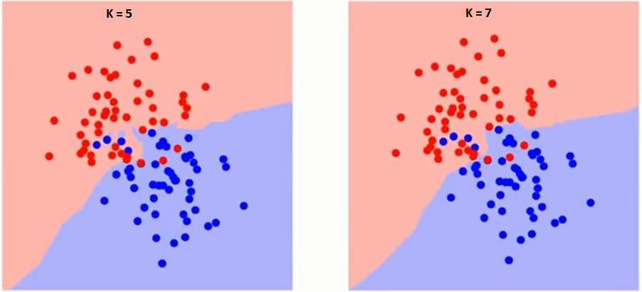

Slide 53
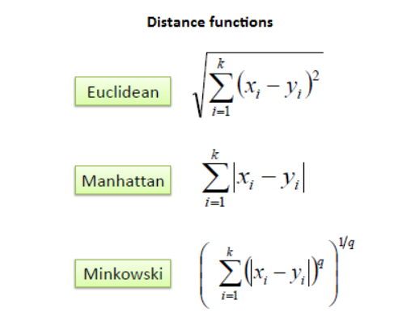
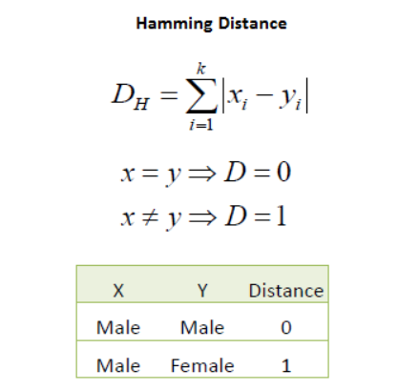
Different Distance Metrics

Slide 54
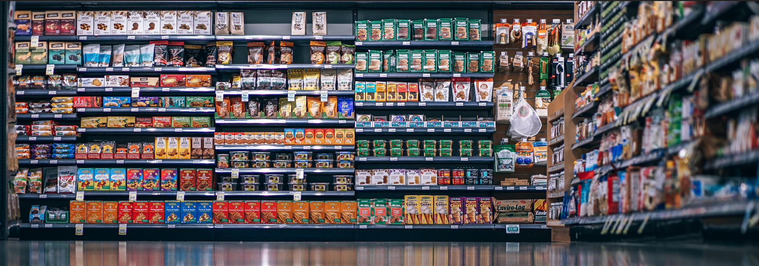
Association rule

Slide 55
Association Rule
What does the value of one feature tell us about the value of another feature?
Findings goal of association rule: features (dimensions) which are “correlated”
In General, we can say that if condition A tends to B it does not necessarily mean that B tends to A. Watch the directionality!

Slide 56
Example
People who visit webpage X are likely to visit webpage Y
People who have age-group [30,40] & income [>$100k] are likely to own home

Slide 57
The measures of effectiveness of the rule are as Follows:
Support
Confidence
Lift
Notes:
More item, more support
This measure gives an idea of how frequent an itemset is in all the transactions. Consider itemset1 = {bread} and itemset2 = {shampoo}.
Value of support helps us identify the rules worth considering for further analysis.
confidence is the conditional probability of occurrence of consequent given the antecedent

Slide 58
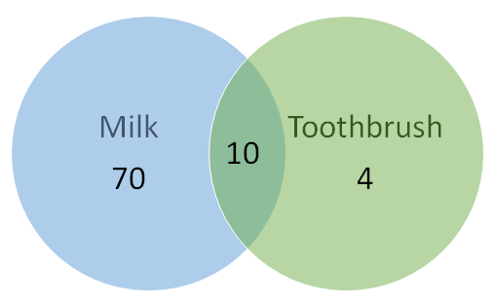
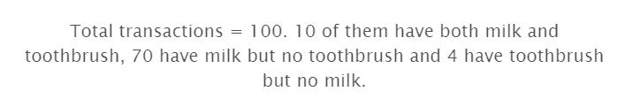
Example
Consider the numbers from figure on the left. Confidence for {Toothbrush} → {Milk} will be 10/(10+4) = 0.7
But we know intuitively that these two products have a weak association and there is something misleading about this high confidence value.
Lift

Slide 59
Lift
Lift controls for the support (frequency) of consequent while calculating the conditional probability of occurrence of {Y} given {X}.
Probability of having milk on the cart with the knowledge that toothbrush is present (i.e. confidence) : 10/(10+4) = 0.7
Now to put this number in perspective, consider the probability of having milk on the cart without any knowledge about toothbrush: 80/100 = 0.8
These numbers show that having toothbrush on the cart actually reduces the probability of having milk on the cart to 0.7 from 0.8! This will be a lift of 0.7/0.8 = 0.87.
A value of lift less than 1 shows that having toothbrush on the cart does not increase the chances of occurrence of milk on the cart in spite of the rule showing a high confidence value.
Apriori algorithm

Slide 60
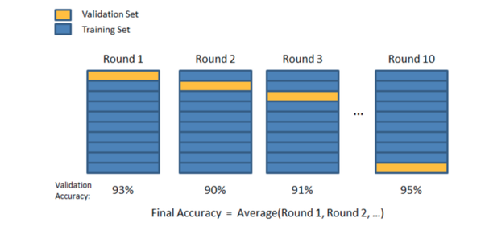
Cross Validation
Cross-validation is a technique that is used for the assessment of how the results of statistical analysis generalize to an independent data set.
Cross-validation is largely used in settings where the target is prediction and it is necessary to estimate the accuracy of the performance of a predictive model.

Slide 61
Validation Benefits
Validation help us evaluate the quality of the model
Validation help us select the model which will perform best on unseen data
Validation help us to avoid overfitting and underfitting.
Notes:
Underfitting refers to not capturing enough patterns in the data. The model performs poorly both in the training and the test set.
Overfitting refers: a)capturing noise and b) capturing patterns which do not generalize well to unseen data. The model performs extremely well to the training set but poorly on the test set.

Slide 62
Different validation strategies
Train/Test split or Holdout: # groups =2
K-fold: # groups = k
Leave one out : # groups = len(train)
Stratification
Notes:
exist based on the number of splits being done in the dataset.
in other words its low on bias and variance.

Slide 63
Train/Test split or Holdout
In this strategy, we simply split the data into two sets: train and test set so that the sample between train and test set do not overlap, if they do we simply can’t trust our model.
major disadvantage:
What if the split we make isn’t random?
This will result in overfitting, even though we’re trying to avoid it! as it is not certain which data points will end up in the validation set and the result might be entirely different for different sets. Thus, it is a good choice only if we have enough data.
it still suffers from issues of high variance

Slide 64
K-fold
It can be viewed as repeated holdout and we simply average scores after K different holdouts.
In K Fold cross validation, the data is divided into k subsets. Now the holdout method is repeated k times, such that each time, one of the k subsets is used as the test set/ validation set and the other k-1 subsets are put together to form a training set.
Every data point gets to be in a validation set exactly once, and gets to be in a training set k-1times.
This significantly reduces underfitting as we are using most of the data for fitting, and also significantly reduces overfitting as most of the data is also being used in validation set.
This method is a good choice when we have a minimum amount of data
Notes:
As there is never enough data to train a model, removing a part of it for validation poses a problem of underfitting. By reducing the training data, we risk losing important patterns/ trends in data set, which in turn increases error induced by bias.
we choose k=5 or k=10

Slide 65
In k-Fold how many folds to use?
As the number of folds increasing:
The error due the bias decreasing but increasing the error due to variance
The computational price would go up.
Obviously, you need more time to compute it and you would need more memory.
With a lower number of folds:
Reducing the error due to variance
Error due to bias would be bigger.
It’s would also computationally cheaper.
General advice for big dataset usually k = 3 or k = 5 is a preferred

Slide 66
Leave one out
It is a special case of K-fold when K is equal to the number of samples in our dataset. This means that will iterate through every sample in our dataset each time using k-1 object as train samples and 1 object as test set.
This method can be useful if we have too little data and fast enough model to retrain.
Notes:
Leave-P-Out

Slide 67
Stratification
With stratification we achieve similar target distribution over different folds when we split the data
Benefits:
Small datasets
Unbalanced datasets
Multiclass classification
Notes:
In that case, it is possible different target distribution to be applied to different folds. With stratification we achieve similar target distribution over different folds when we split the data.

Slide 68
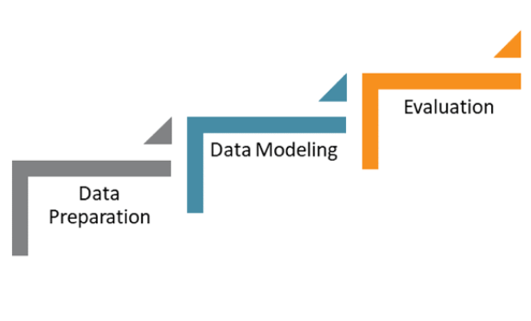
The End
Navid Mohseni
Notes:
98

